Slide 1


TSSM’s Bhivarabai Sawant College of Engineering & Research Narhe, Pune-41
Department of Electronics & Telecommunication Engineering
A PRESENTATION ON
TinyML-Based Vibration Anomaly Detection System
For Predictive Maintenance
Presented By Armaan Ali Atharva Nhavakar Parth Ghare
Guide Name
Prof. P .A Patil
Academic Year 2025-26

Slide 2
Contents
Introduction
Literature Review
Motivation
Problem Statement
Objectives
Methodology
System Architecture
Results
Conclusion
Future Scope
References

Slide 3
Introduction
The rapid growth of Industry 4.0 has increased the demand for intelligent and automated maintenance systems. Predictive maintenance helps detect machine faults before they lead to breakdowns, reducing downtime, maintenance costs, and production losses.
Among various monitoring techniques, vibration analysis is one of the most effective methods for identifying faults in rotating machinery such as motors and pumps. Mechanical issues like imbalance, misalignment, and bearing wear generate unique vibration patterns that can be detected at an early stage.
Conventional monitoring systems often rely on expensive hardware and continuous cloud connectivity for data processing. In this project, we propose a TinyML-based edge AI solution that performs real-time vibration analysis directly on a low-cost microcontroller. This enables fast, low-power, and standalone fault detection, making predictive maintenance more affordable and practical for small and medium industries.

Slide 4
Problem Statement
Existing vibration monitoring systems are expensive, cloud-dependent, and primarily designed for large-scale industries. Most solutions require specialized data acquisition hardware, continuous internet connectivity, and powerful computing resources, making them unsuitable for small and medium enterprises (SMEs). As a result, many industries continue to rely on reactive maintenance, leading to unexpected equipment failures, increased downtime, and higher maintenance costs.
Key Gaps Addressed by Our Project
No affordable TinyML-based predictive maintenance solution for SMEs.
Heavy dependence on cloud servers for vibration analysis and fault detection.
High-cost industrial monitoring systems requiring specialized DAQ hardware.
Lack of real-time, on-device motor health classification on low-cost microcontrollers.
Limited deployment of lightweight AI models on embedded hardware for standalone operation.
Need for a compact system capable of detecting motor faults (Healthy vs. Faulty) with low latency and low power consumption.
Absence of an integrated, portable solution suitable for deployment in industries with limited or no internet connectivity.

Slide 5
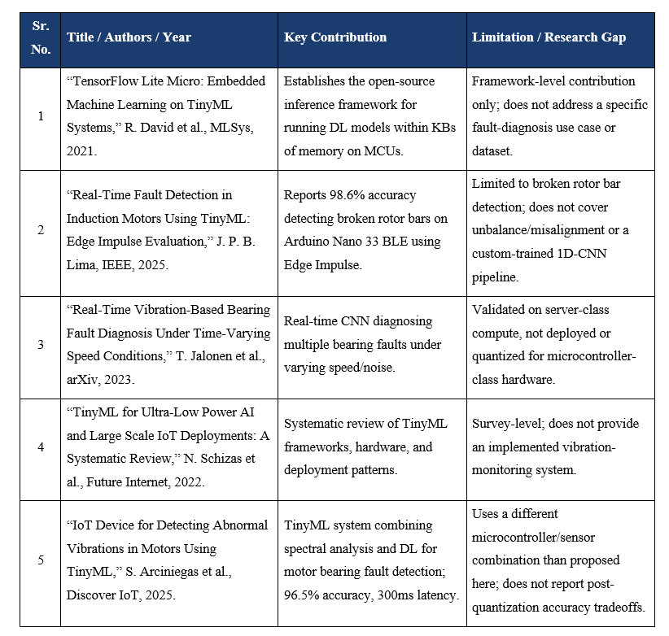
Literature Survey

Slide 6
Motivation
The rapid growth of Industry 4.0 has increased the demand for intelligent and automated maintenance systems. Unexpected failures of rotating machinery such as motors and pumps can lead to production downtime, financial losses,. and reduced equipment lifespan. Early detection of such faults is essential for improving operational efficiency and ensuring reliable industrial processes
With the emergence of TinyML, it is now possible to run machine learning models directly on low-power embedded devices. This inspired us to develop a compact, cost-effective, and standalone predictive maintenance system capable of performing real-time vibration analysis without relying on cloud infrastructure.

Slide 7
Objectives
To collect and analyze vibration signatures of a motor under healthy and induced-fault (unbalance/misalignment) operating conditions.
To extract meaningful time-domain (RMS, kurtosis, crest factor) and frequency-domain (FFT peaks, spectral energy) features from the raw vibration signal.
To design, train, and compare lightweight machine learning models (baseline classifier vs. compact 1D-CNN) for motor health classification.
To quantize and deploy the trained model on a microcontroller (Arduino Nano 33 BLE Sense) using TensorFlow Lite for Microcontrollers.
To validate the system's real-time fault detection performance on a live motor rig and trigger a visual/audible alarm upon anomaly detection.

Slide 8
Methodology
1. Data Acquisition
Collect vibration data from the motor using the onboard accelerometer under healthy and faulty conditions.
2. Preprocessing
Extract important time-domain (RMS, Kurtosis, Crest Factor) and frequency-domain (FFT Peak, Spectral Energy) features.
3. Model Training
Train and compare lightweight machine learning models (Random Forest and 1D-CNN) for motor fault classification.
4. Model Optimization
Optimize the selected model using INT8 quantization and convert it to TensorFlow Lite format.
5. Deployment
Deploy the optimized model on the Arduino Nano 33 BLE Sense for real-time fault detection and alerts.
6. Validation
Evaluate the system on a live motor setup by measuring detection accuracy and inference speed.

Slide 9
Methodology
⚙️ Hardware Requirements
🧩 Component | 🎯 Purpose
Arduino Nano 33 BLE Sense | Vibration sensing & TinyML inference
Test Motor / Pump | Generate vibration data
LED / Buzzer | Fault indication
SD Card Module | Data logging
💻 Software Requirements
🛠️ Software | 🎯 Purpose
Python 3.x | Data preprocessing & model training
TensorFlow / Keras | Build and train ML model
TensorFlow Lite Micro | Deploy model on Arduino
Arduino IDE | Upload firmware

Slide 10
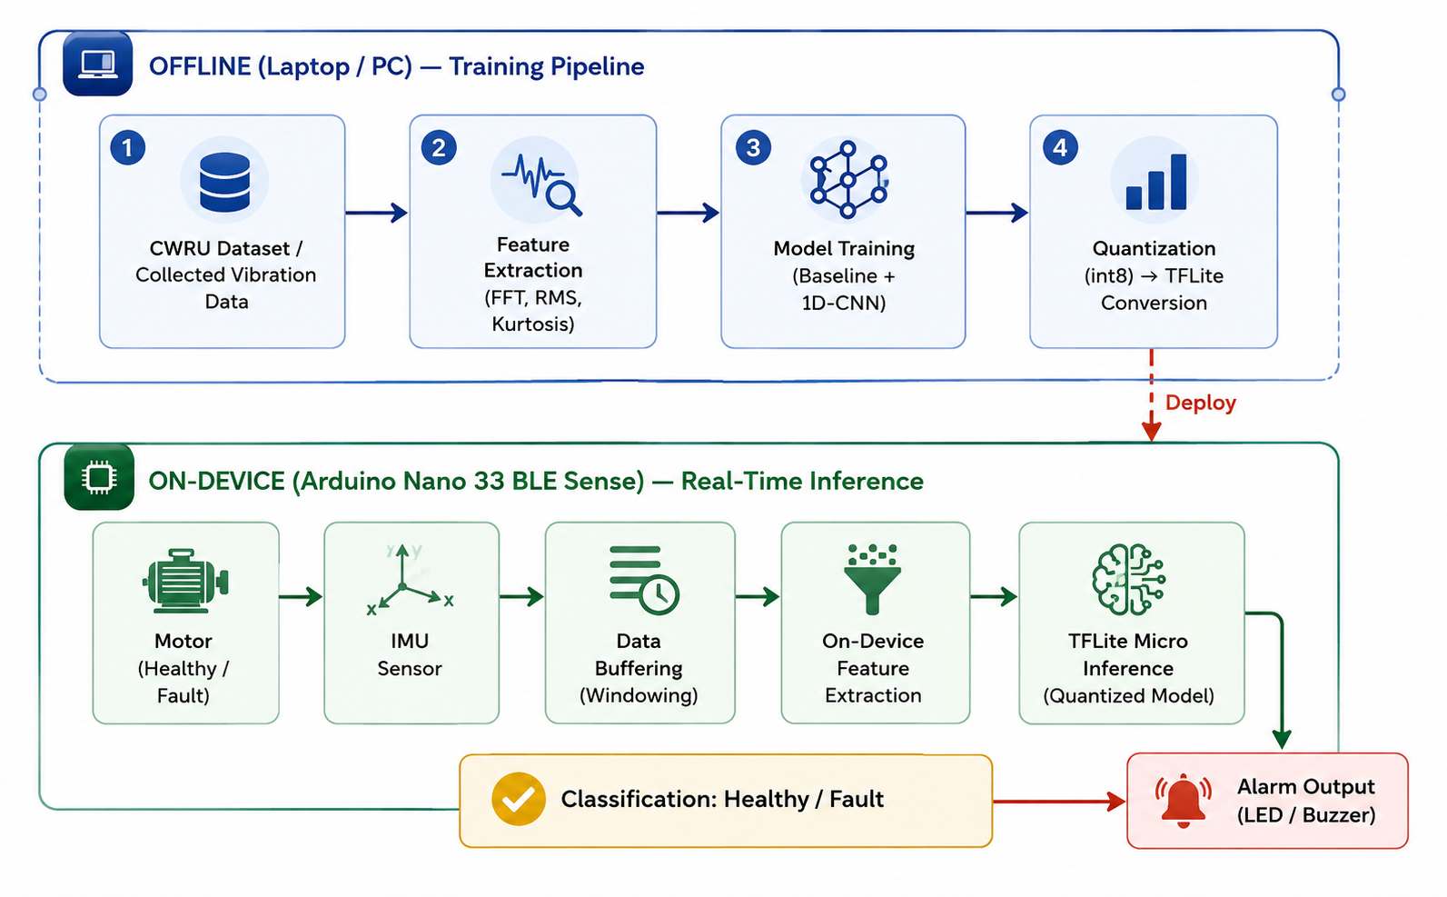
System Design/Architecture

Slide 11
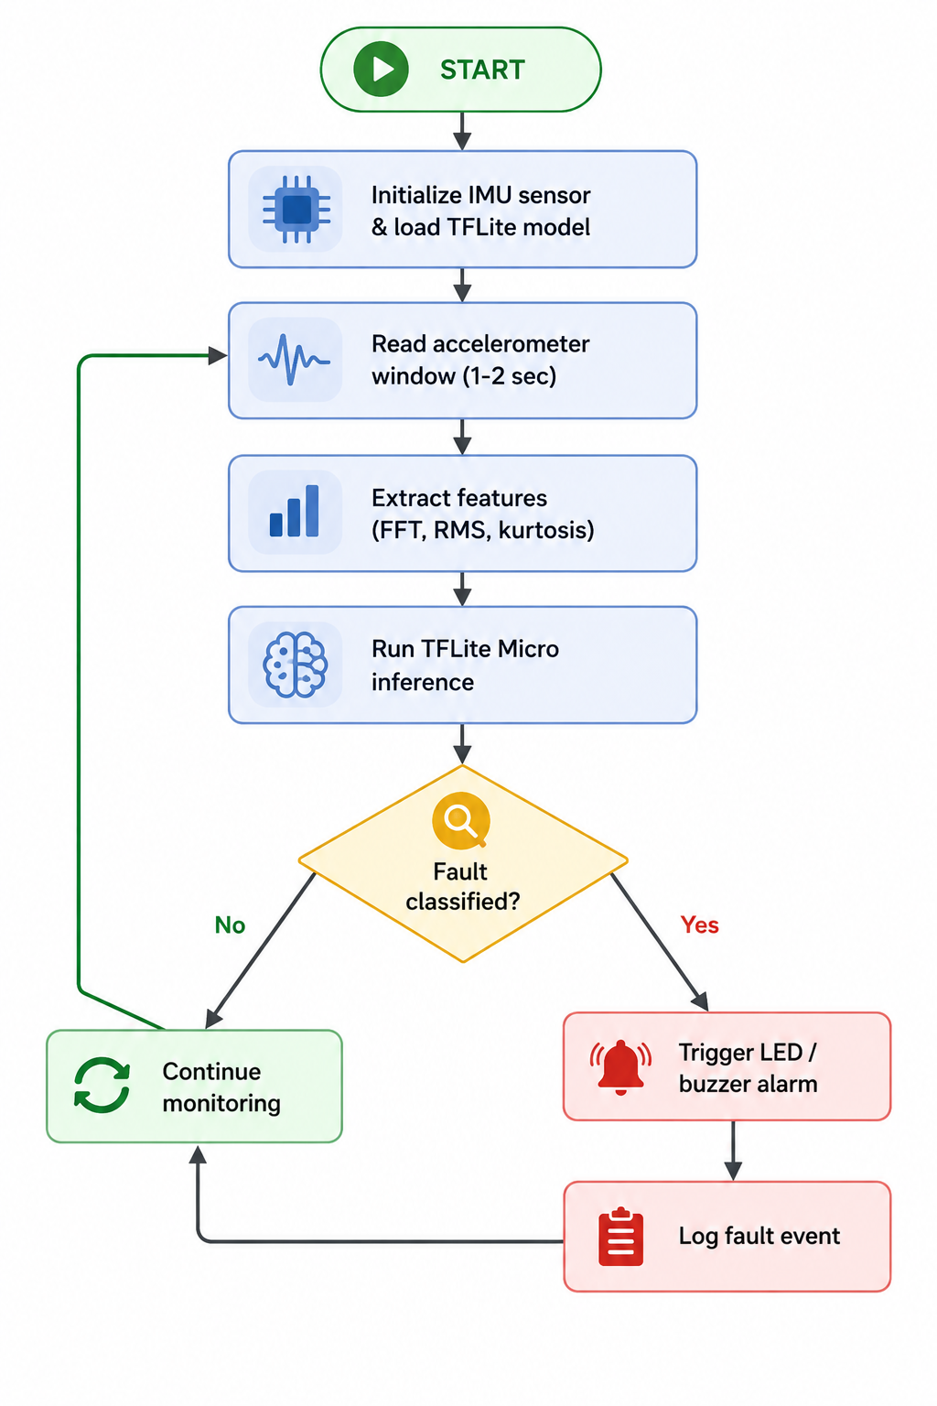
FLOWCHART/ALGORITHM

Slide 12
Conclusion and Future Scope
Future Scope:
Detect additional fault types such as bearing wear, looseness, and shaft cracks.
Integrate acoustic sensing alongside vibration analysis for improved accuracy.
Enable wireless monitoring using BLE/Wi-Fi with a real-time dashboard.
Enhance model performance using federated learning across multiple devices.
Implement advanced anomaly detection to identify previously unseen faults.

Slide 13
References
R. David et al., "TensorFlow Lite Micro: Embedded Machine Learning on TinyML Systems," in Proc. Machine Learning and Systems (MLSys), vol. 3, 2021, pp. 800–811.
J. P. B. Lima, "Real-Time Fault Detection in Induction Motors Using TinyML: An Evaluation of the Edge Impulse Platform," IEEE, 2025.
T. Jalonen, M. Al-Sa'd, S. Kiranyaz, and M. Gabbouj, "Real-Time Vibration-Based Bearing Fault Diagnosis Under Time-Varying Speed Conditions," arXiv:2311.18547, 2023.
N. Schizas, A. Karras, C. Karras, and S. Sioutas, "TinyML for Ultra-Low Power AI and Large Scale IoT Deployments: A Systematic Review," Future Internet, vol. 14, no. 12, p. 363, 2022.
S. Arciniegas, D. Rivero, J. Piñan, E. Diaz, and F. Rivas, "IoT Device for Detecting Abnormal Vibrations in Motors Using TinyML," Discover Internet of Things, vol. 5, no. 1, p. 41, 2025.

Slide 14
Thank You!!!

